Slide 1

COMP 3962 Cloud Computing Platforms
Lab 3

Slide 2



Agenda
Cloud Storage
S3
IAM Policies
RDS
DynamoDB
EBS, EFS and More

Slide 3

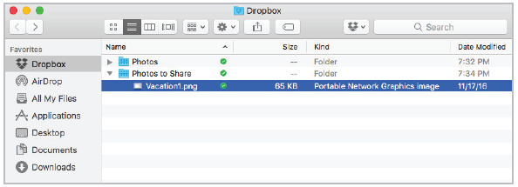
Cloud Storage
Remote storage is housed on an external device that can be accessed from a network
Remote storage can also be available as an Internet service, in which case it is called cloud storage
Cloud storage is provided to individuals by services such as Apple iCloud, Microsoft OneDrive, Google Drive, and Dropbox
Note: Public Cloud vs. Private Cloud

Slide 4
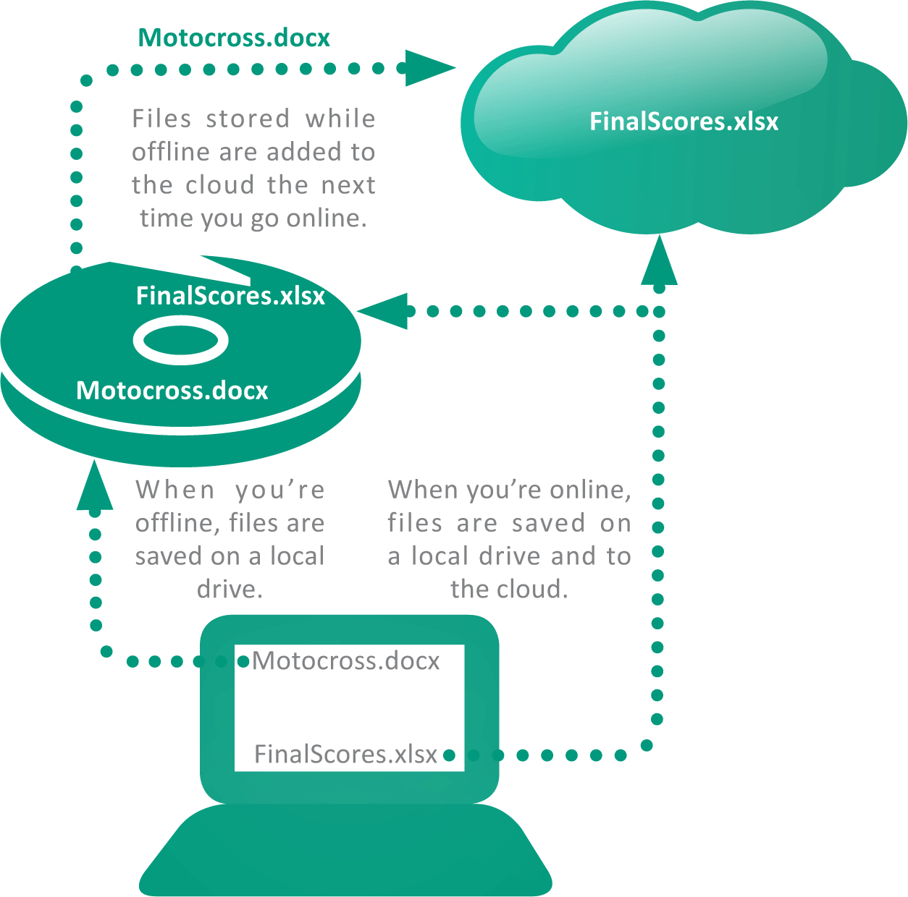
Cloud Storage
Some cloud implementations offer a synchronization feature that automatically duplicates files stored on a local device by also saving them in the cloud.

Slide 5
Cloud Storage Basics
Security and privacy risks
The more places your data is stored and the more networks on which it travels, the more susceptible it becomes to intercepts from hackers and government spying agencies
Service outages
When a Cloud storage site has an outage, all the data stored there becomes temporarily inaccessible
Discontinuation of service
Some Cloud storage providers have closed down their services with little warning

Slide 6

Amazon S3
“Amazon Simple Storage Service (Amazon S3) is an object storage service offering industry-leading scalability, data availability, security, and performance.”
From AWS

Slide 7
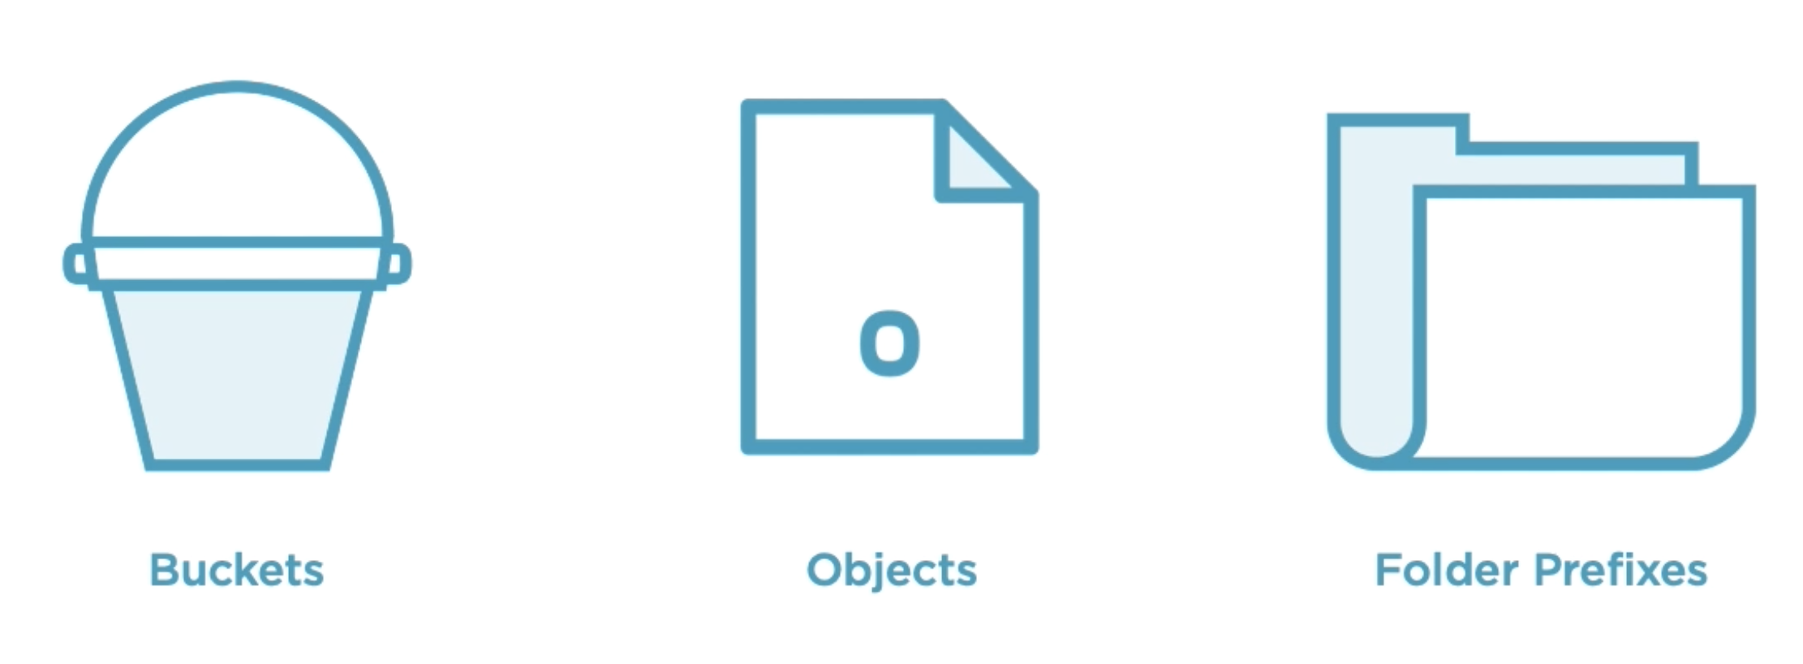

Amazon S3 Basics

Slide 8
Use cases of S3
To host static websites
To Store files ( such as, PDFs, images, etc.)
To Store data (such as, JSON, CSV, XML, etc.)

Slide 9
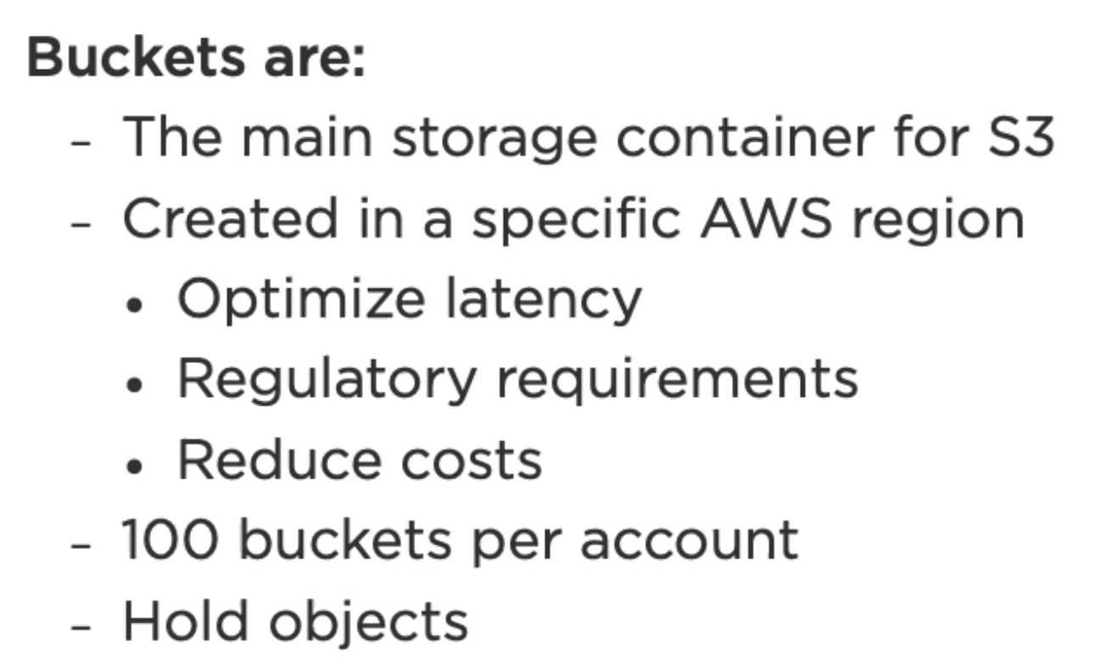
Buckets in S3

Slide 10
S3 Bucket Naming
Globally unique name
Minimum Length: 3 characters
Maximum Length: 63 characters
DNS naming conventions
Lower letters, numbers, periods and hyphens

Slide 11
More on naming Buckets
Should:
Start with letter or number, not period nor hyphen
Cannot:
Have a hyphen or period next to each other
Be an IP address format

Slide 12
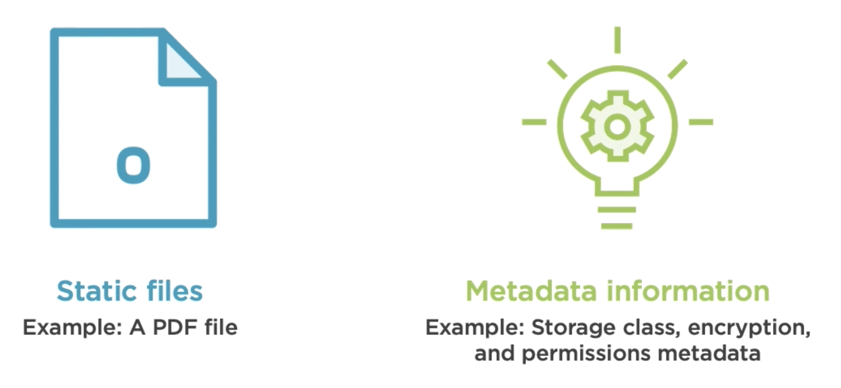
S3 Objects

Slide 13
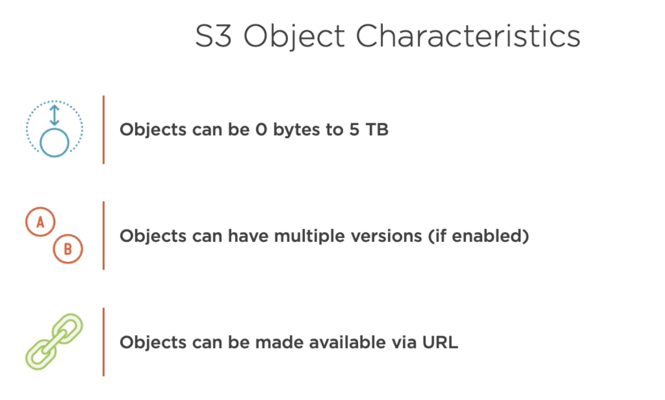

Slide 14
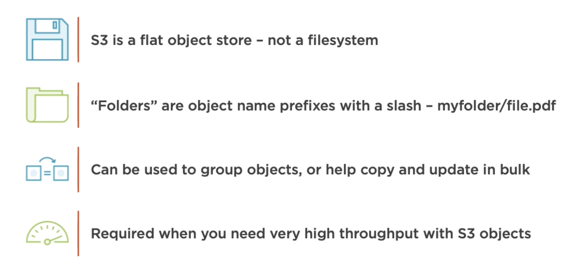
S3 Folder Prefixes

Slide 15
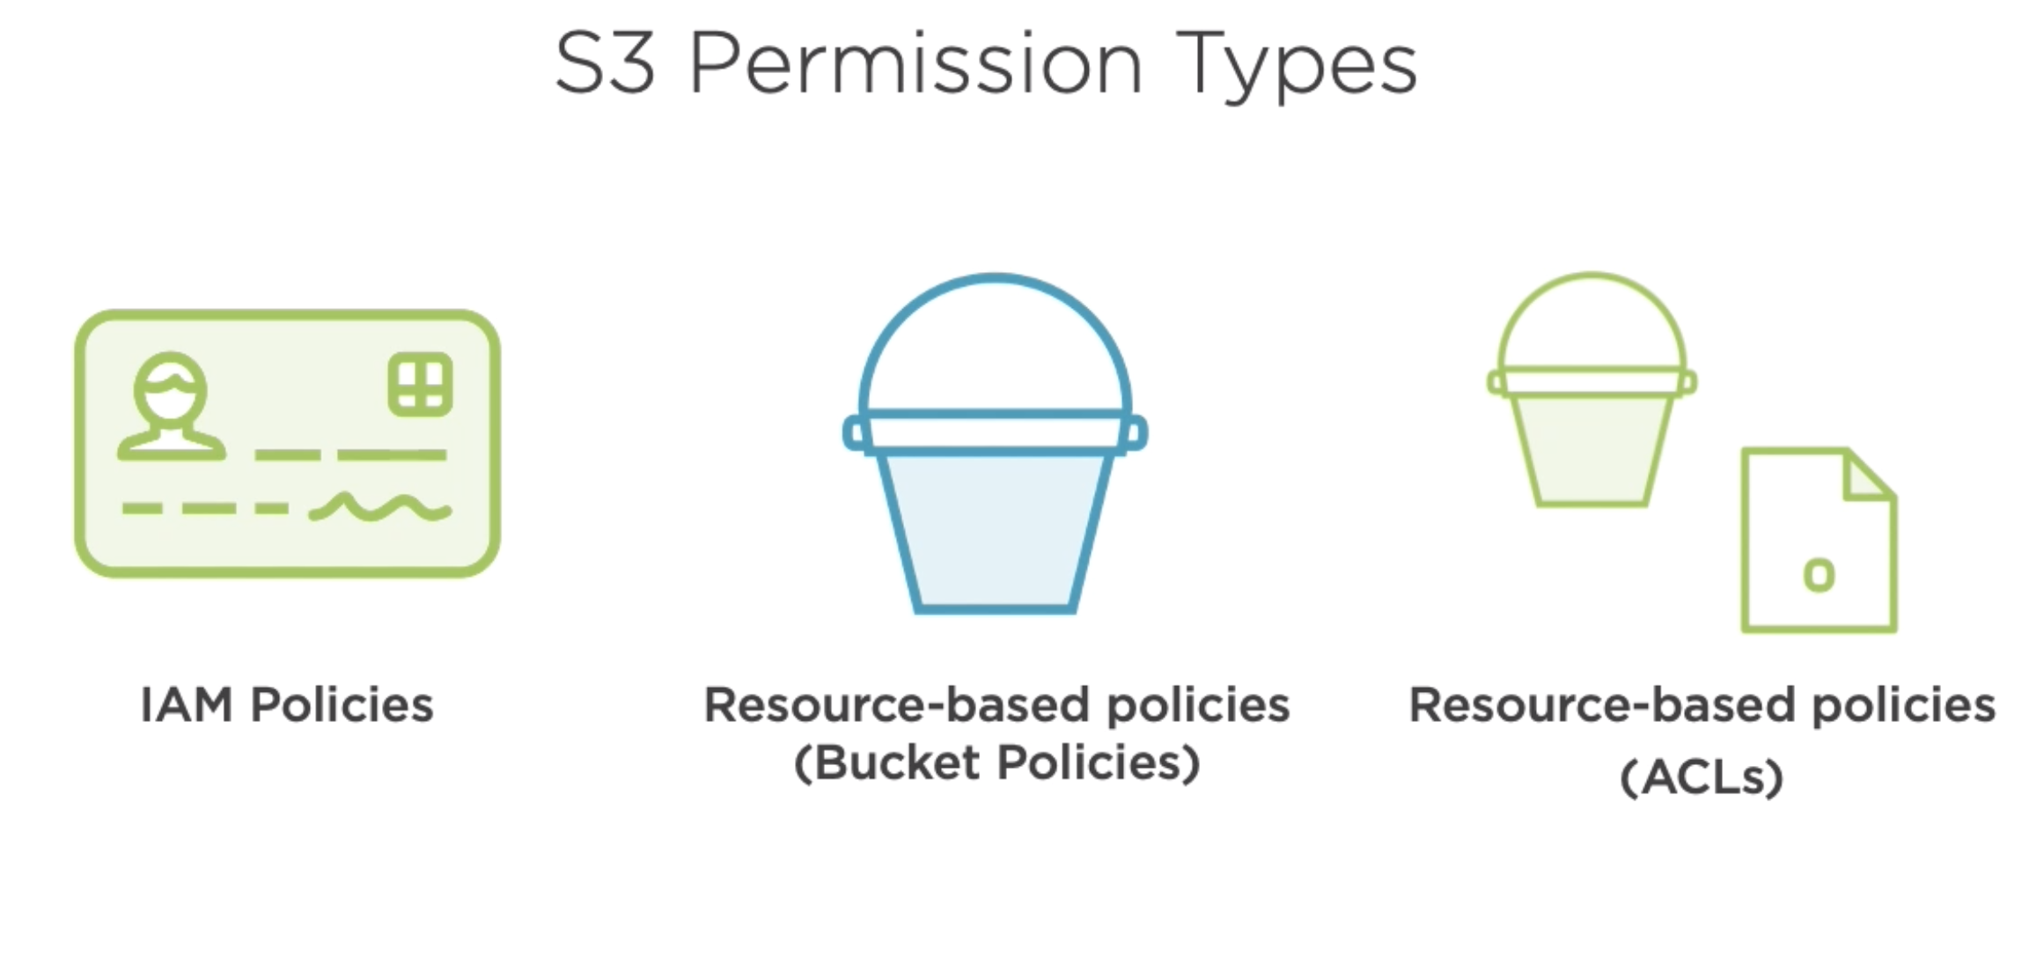

Slide 16
IAM Policy Assignees
Users
Groups
Roles

Slide 17
Bucket Policies
Only used on buckets
Resource-based IAM policy
Grants access to IAM users or other AWS accounts
Grants access to the bucket and/or its objects
Specify allowed and denied actions

Slide 18
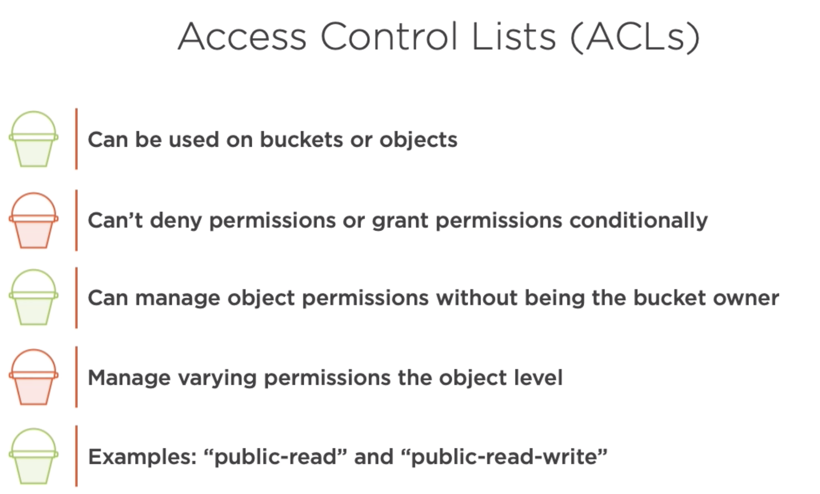

Slide 19
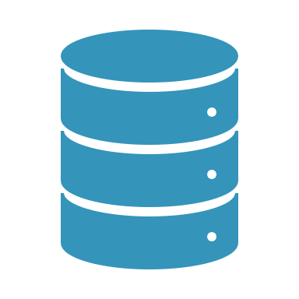
Discussion: Database

Slide 20
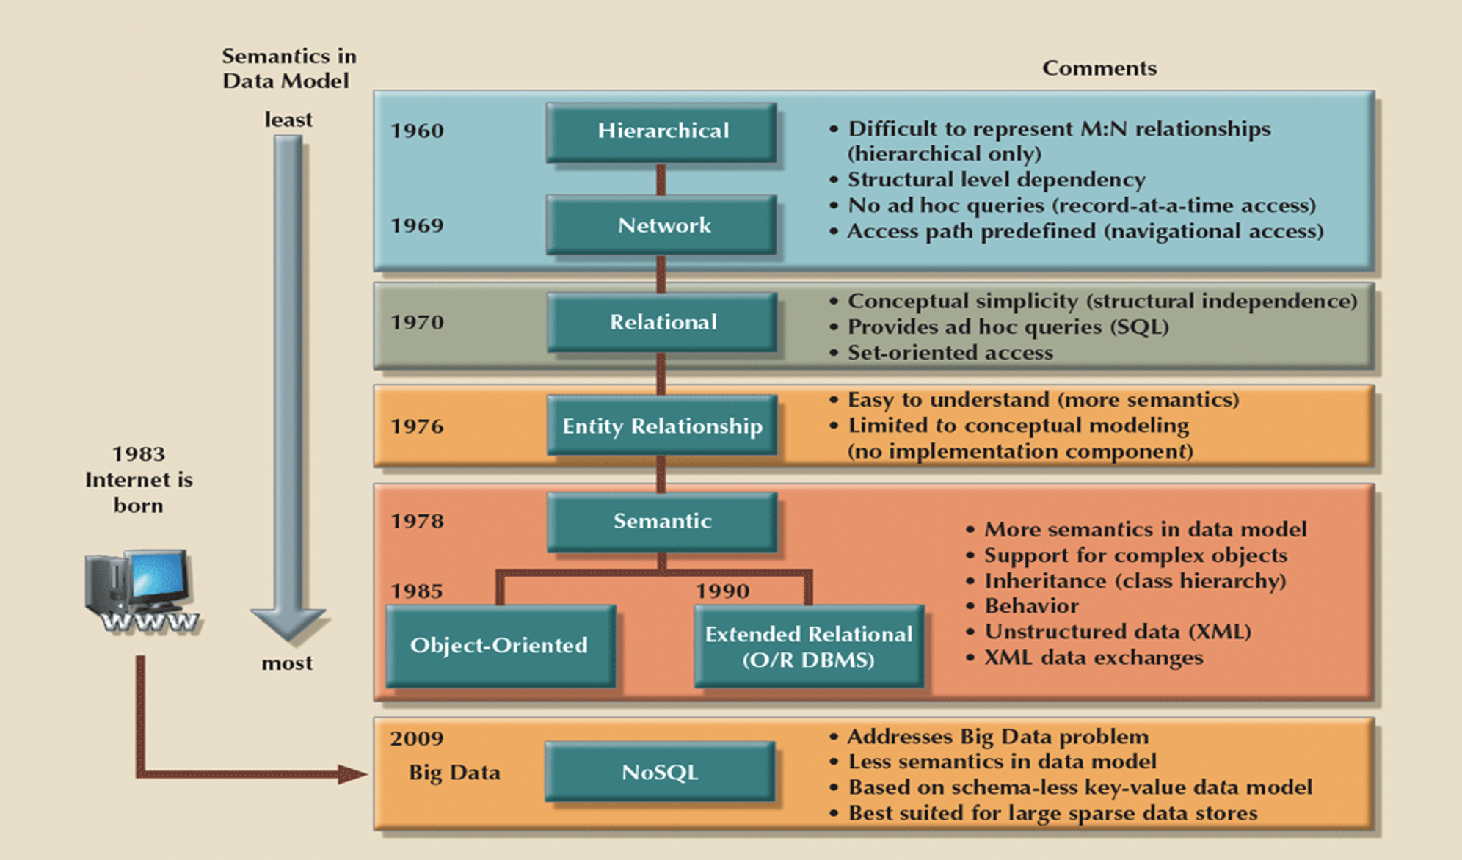

Slide 21
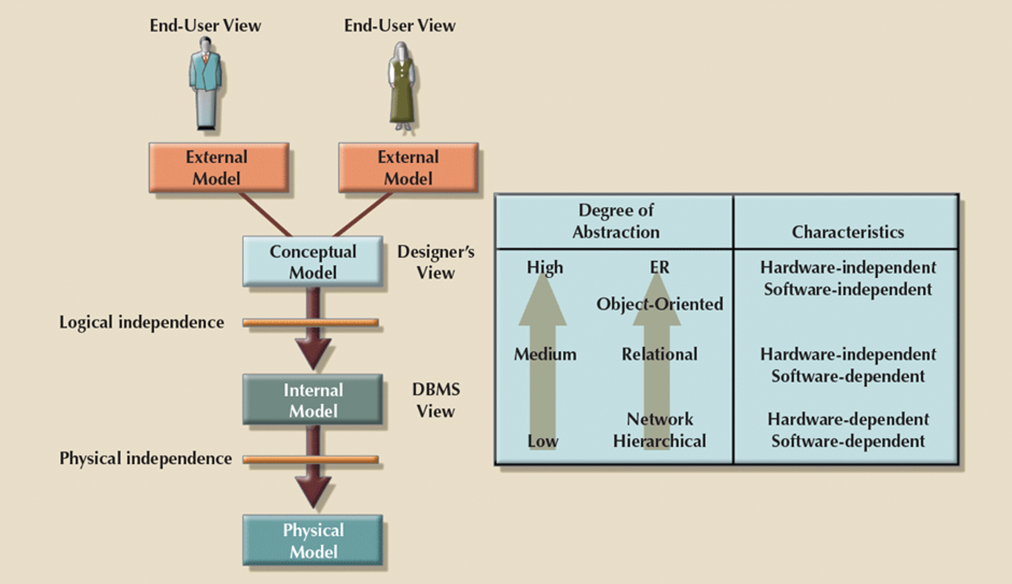

Slide 22
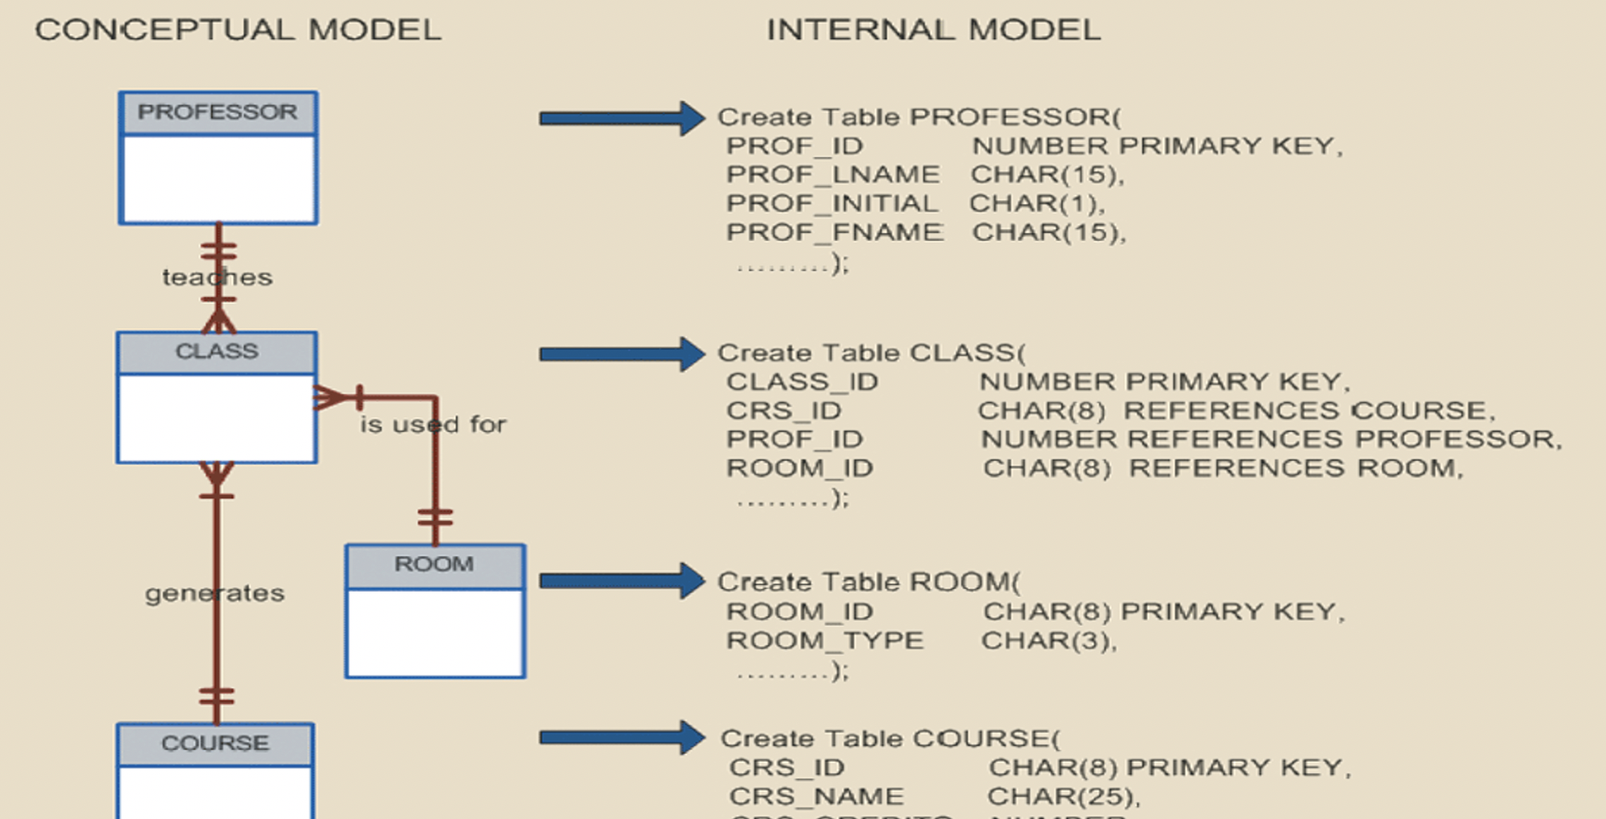

Slide 23

Amazon Relational Database Service (RDS)

Slide 24
Amazon DynamoDB
“Amazon DynamoDB” is a key-value and document database that delivers single-digit millisecond performance at any scale.”
From AWS

Slide 25
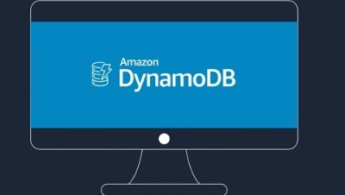

Slide 26
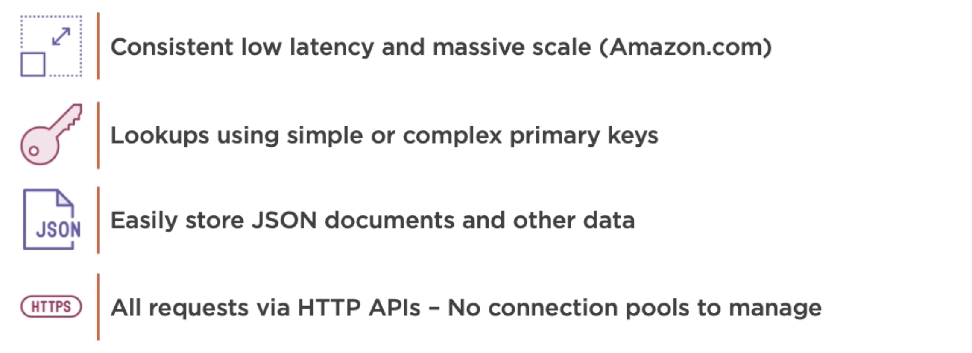
DynamoDB

Slide 27
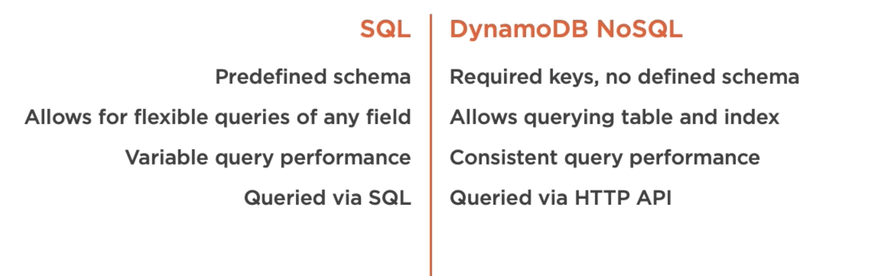
SQL vs. NoSQL (DynamoDB)

Slide 28
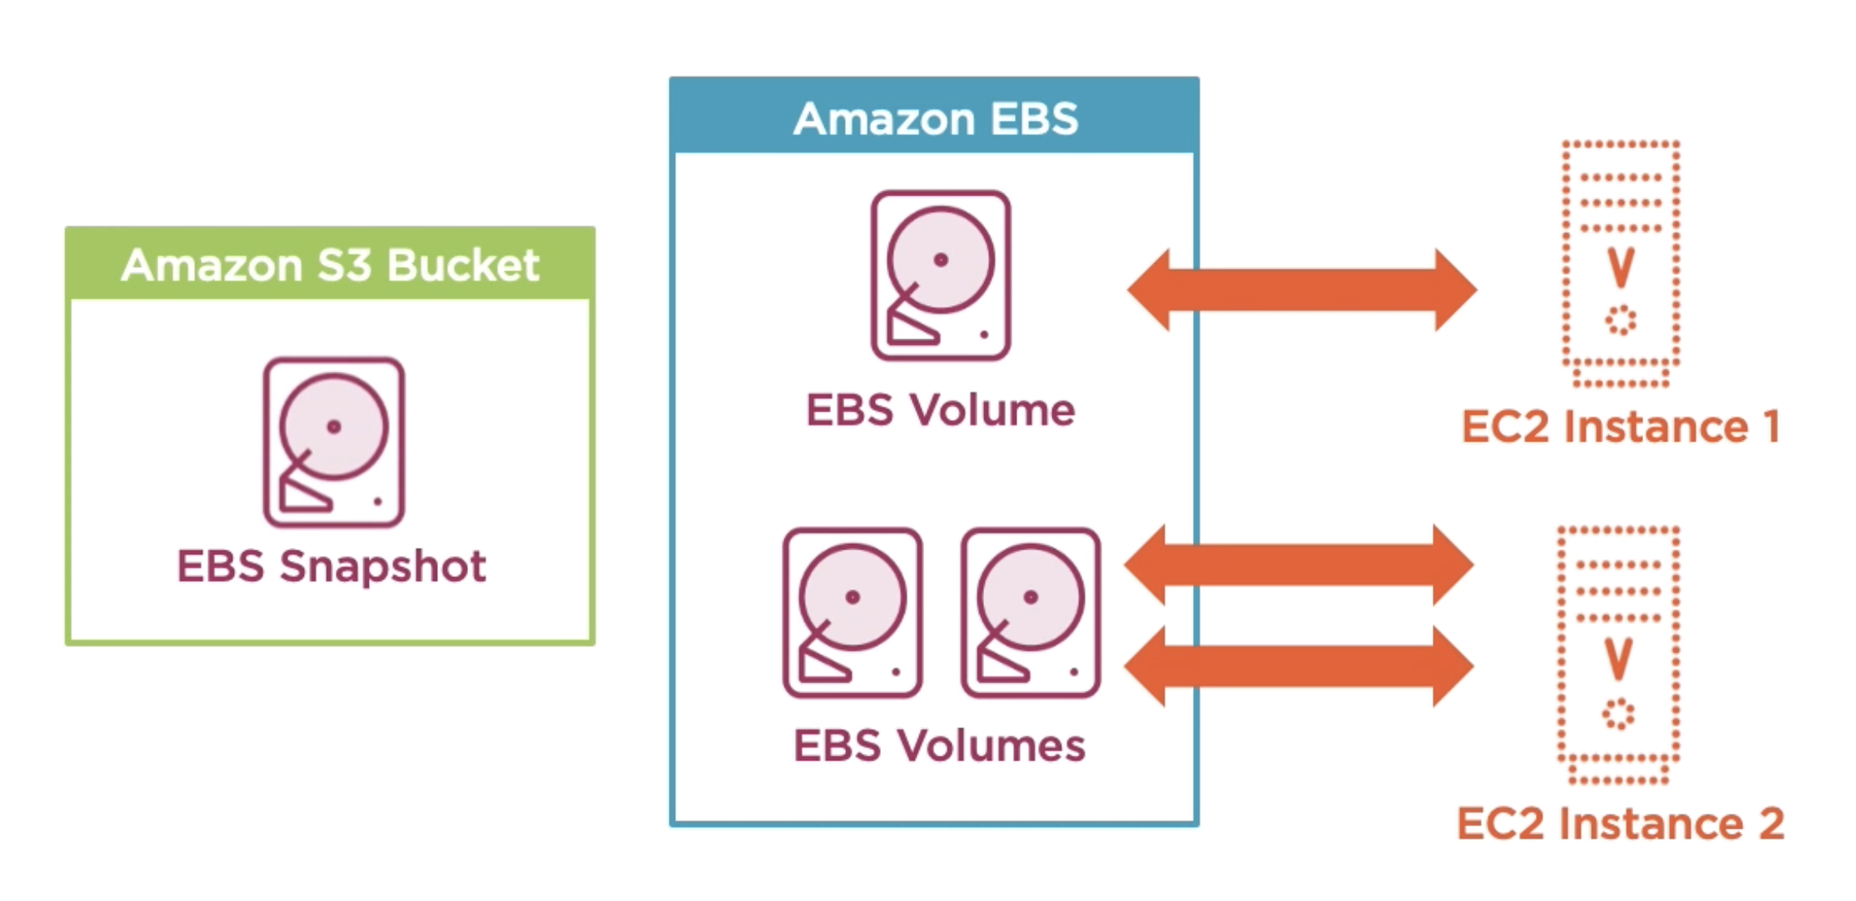
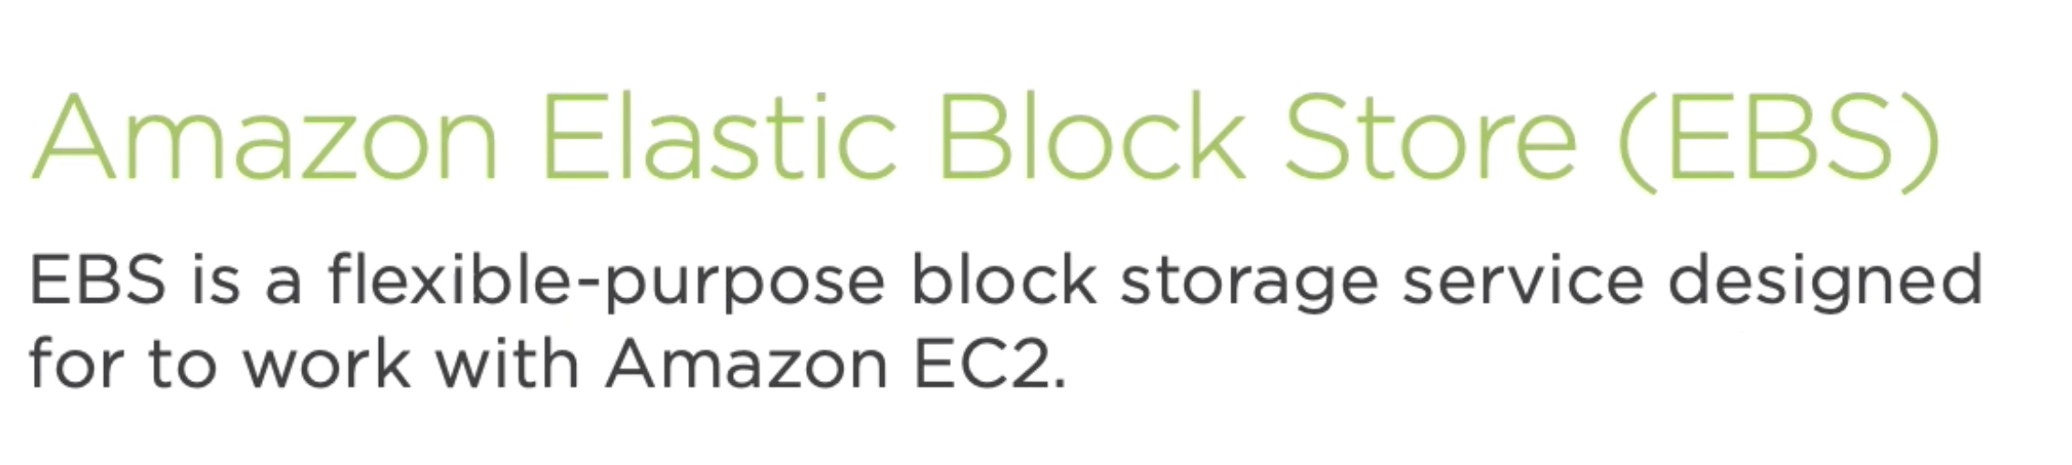

Slide 29
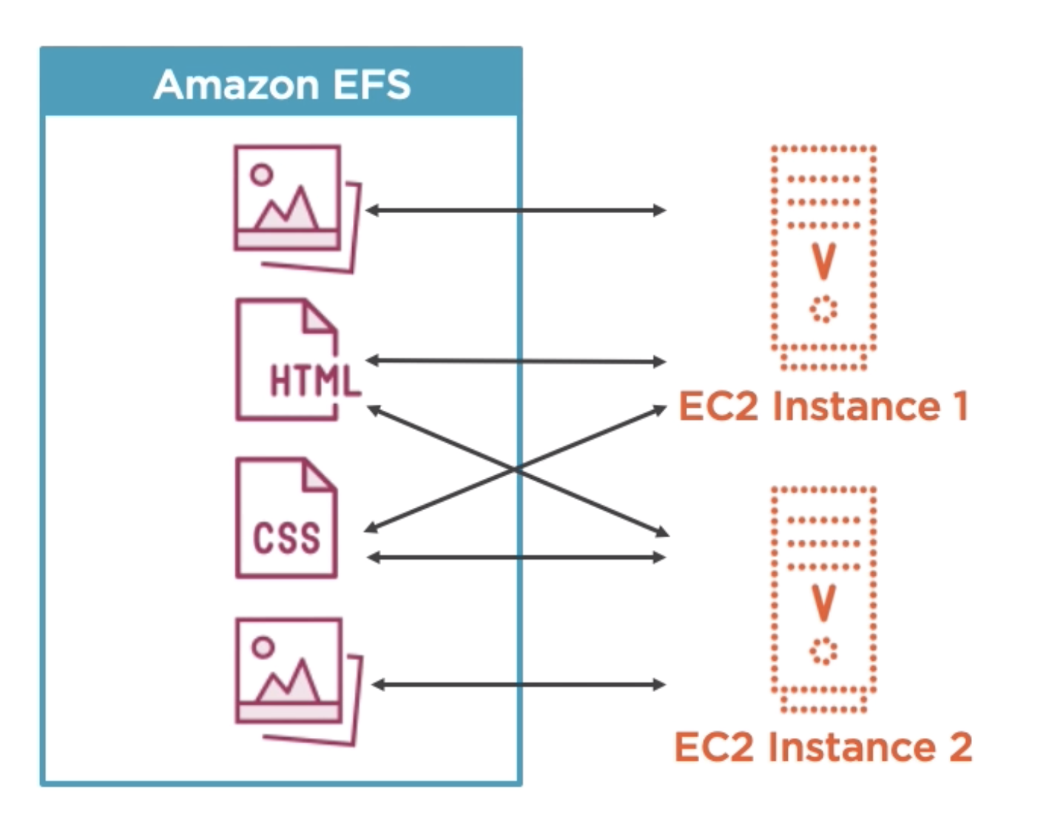
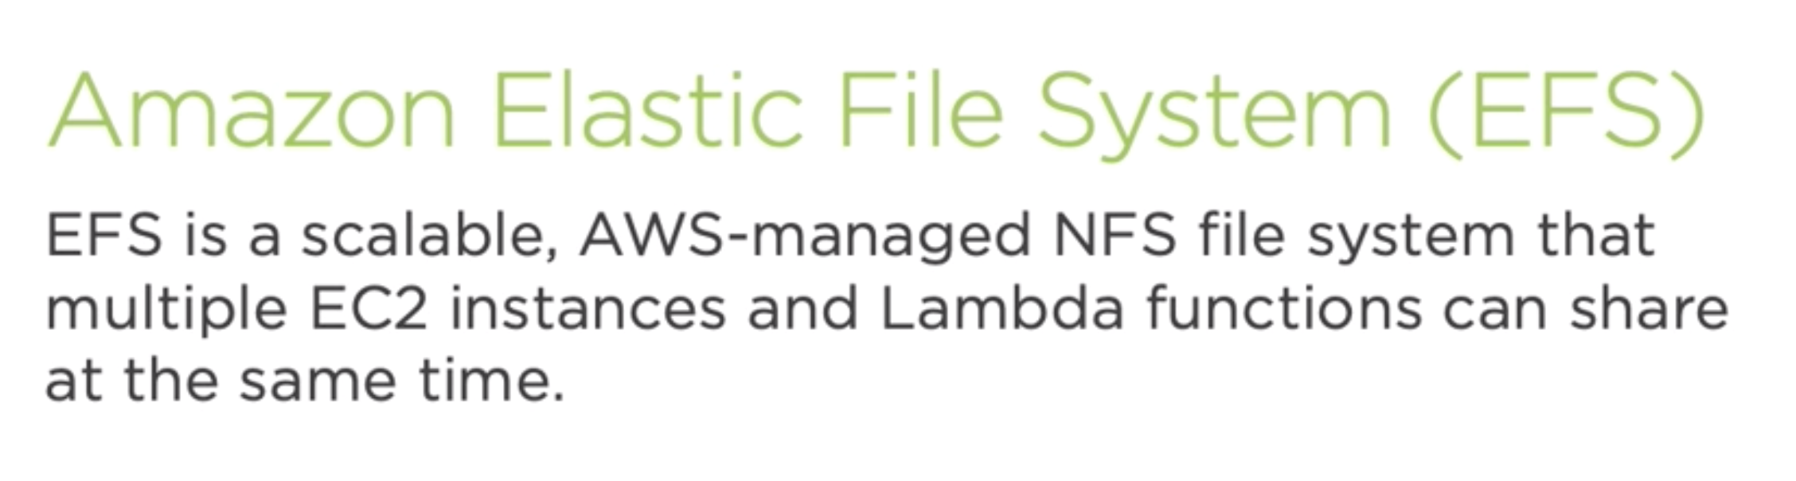
Notes:
NFS file system

Slide 30
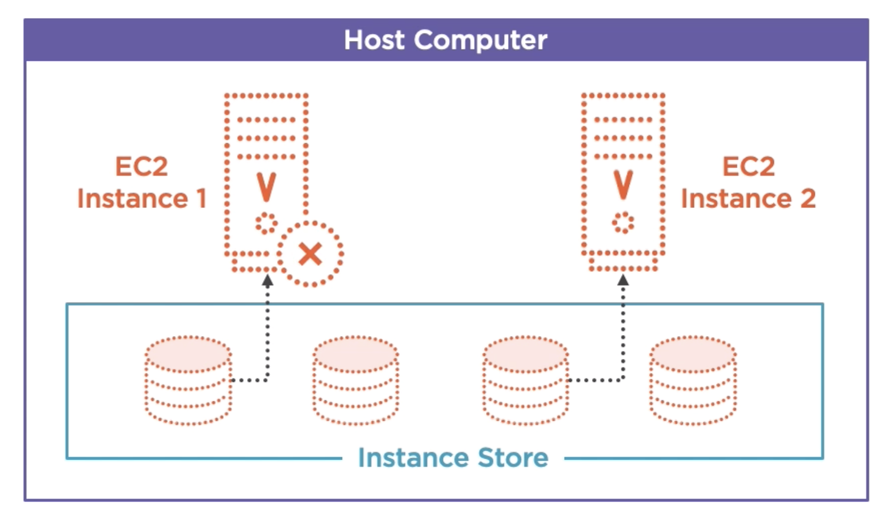
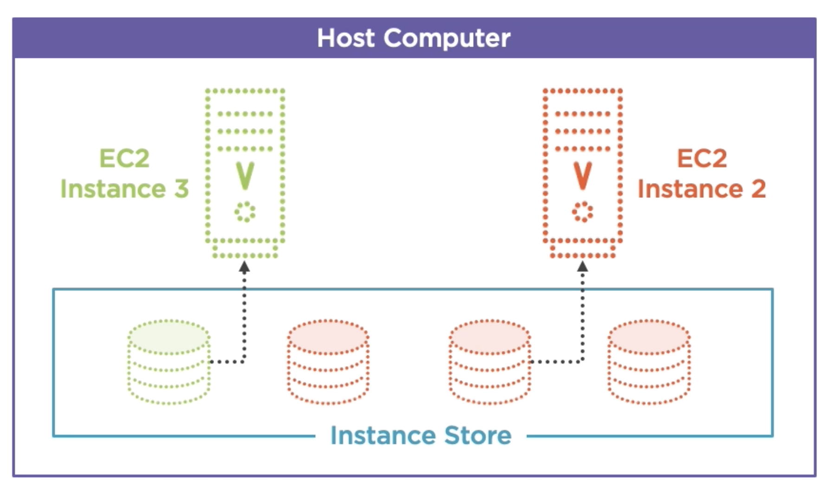
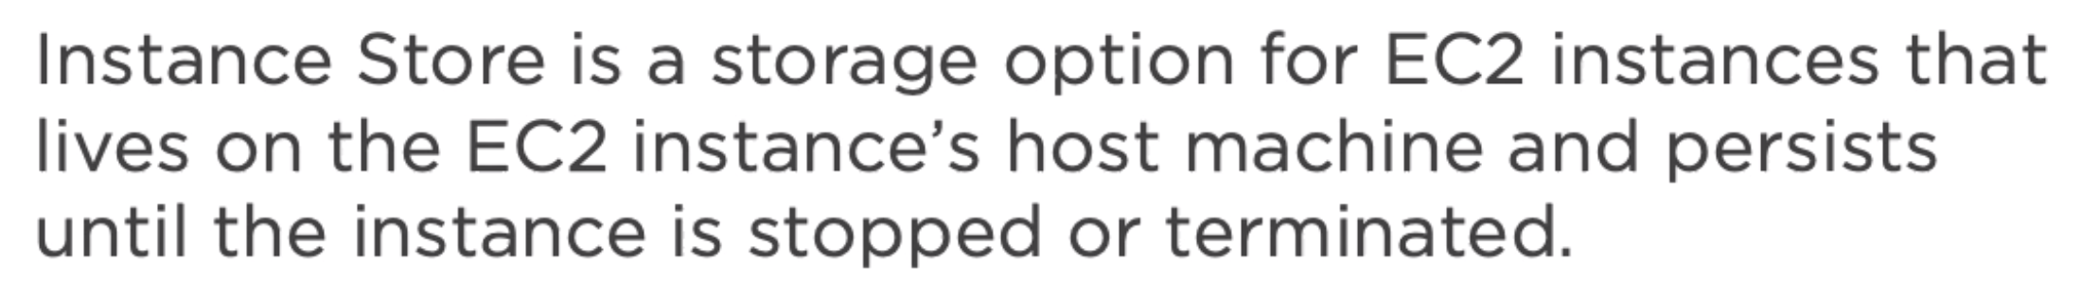
Amazon EC2 Instance Store

Slide 31
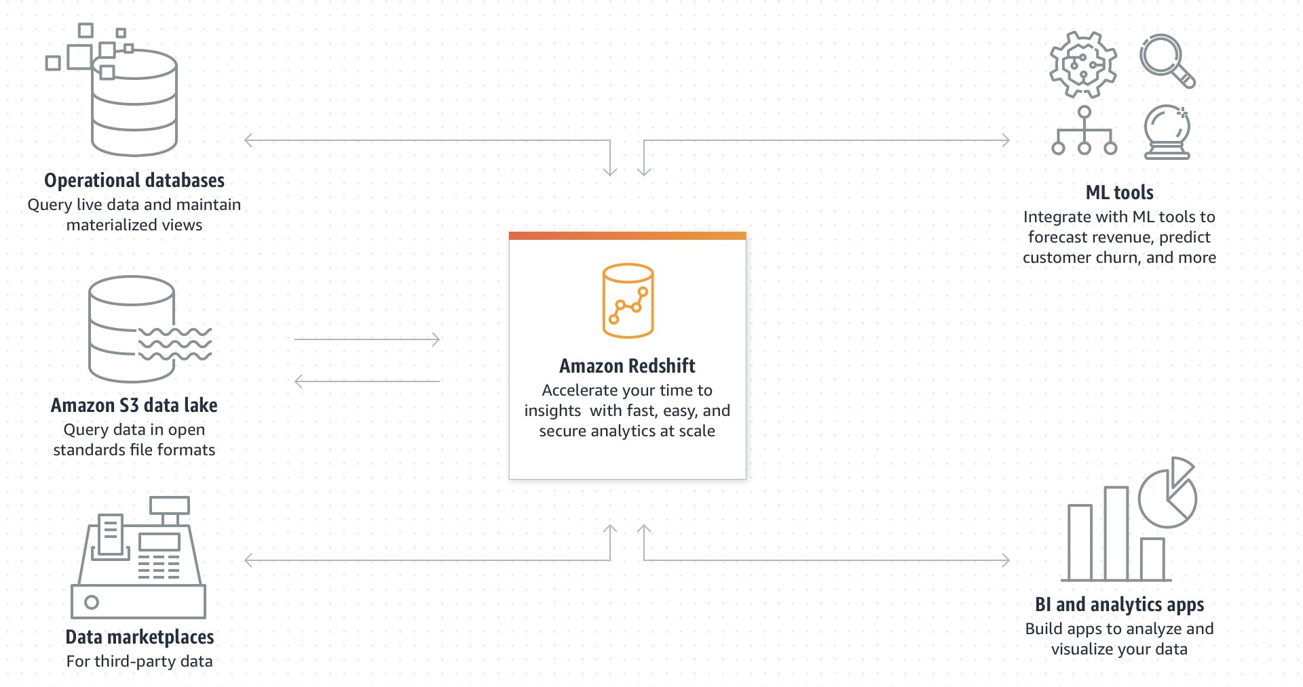
Amazon Redshift

Slide 32
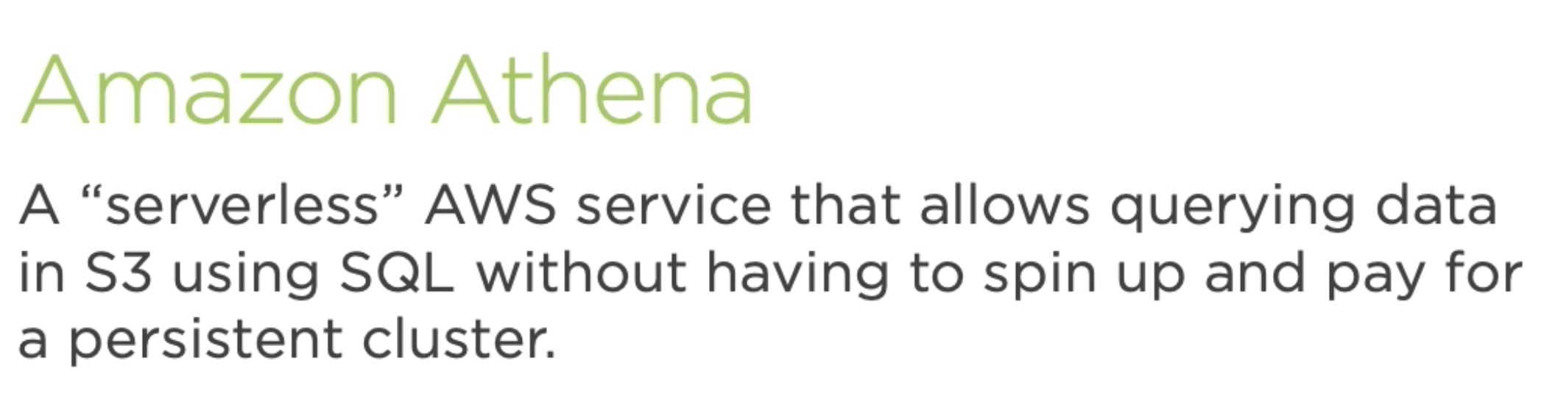
https://aws.amazon.com/athena/getting-started/
Notes:
Amazon Redshift: a cloud-based data warehousing tool designed for petabyte scale data warehousing and analysis.

